Slide 1
The Hospitality
Training Academy
(HTA)
Alexandra Weyman, MSW, Manger of Workforce Innovation
Alexandra.weyman@lahta.org
818-512-6210

Slide 2
About HTA
The Hospitality Training Academy (HTA) is a 501(c)(3) Taft-Hartley/labor-management partnership between UNITE HERE Local 11 and its 160 contributing employers
HTA works not only to up-skill existing employees that are represented by Local 11, but also provides a variety of workforce development, apprenticeship and training programs that are funded by various government agencies to train low income, marginalized individuals for jobs in the hospitality industry.

Slide 3
About UNITE HERE Local 11
UNITE HERE Local 11 is one of the fastest growing private-sector unions in the country
Local 11 represents:
31,000 workers and counting in Los Angeles and Orange Counties and the State of Arizona
Notes:
UNITE HERE Local 11 represents:
-25,000 workers and constantly growing
-In Los Angeles County, Orange County, State of Arizona
-Workers at hotels, restaurants, airports, sports arenas, convention centers, movie studio cafeterias, private universities, bowling alleys, etc.

Slide 4
UNITE HERE Local 11 members work at:
Hotels
Stadiums/Sporting Arenas
Convention Centers
Airports
Airline Catering
Theme Parks
Private University and Movie Studio Cafeterias
Restaurants, Bowling Alleys, Casinos

Slide 5
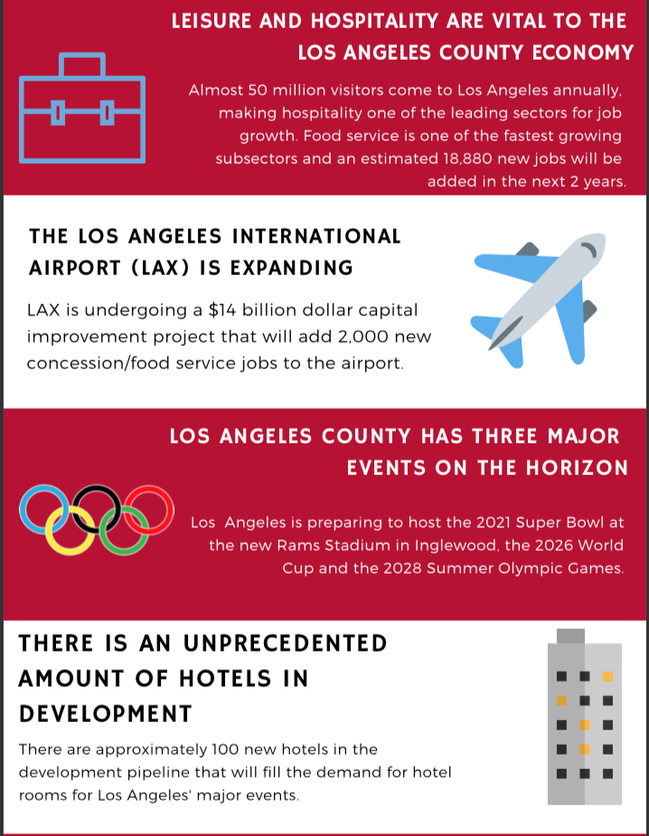
The Hospitality Industry Boom in Los Angeles County

Slide 6
What We Do
As a Taft-Hartley Fund, employers whose employees are represented by UNITE HERE Local 11, contribute to a training fund for existing employees to receive “up-skill” training. This includes ServSafe Food Handler Certification and TiPS Safe Alcohol Service Training, in addition to other trainings requested by employers
The HTA has federal/Workforce Innovation and Opportunity Act (WIOA), state, county and local city funding to work with low-income jobseekers to assist with resumes, mock-interviewing, job/skill training, and then pipeline these clients into a union, hospitality job with good wages and benefits.

Slide 7
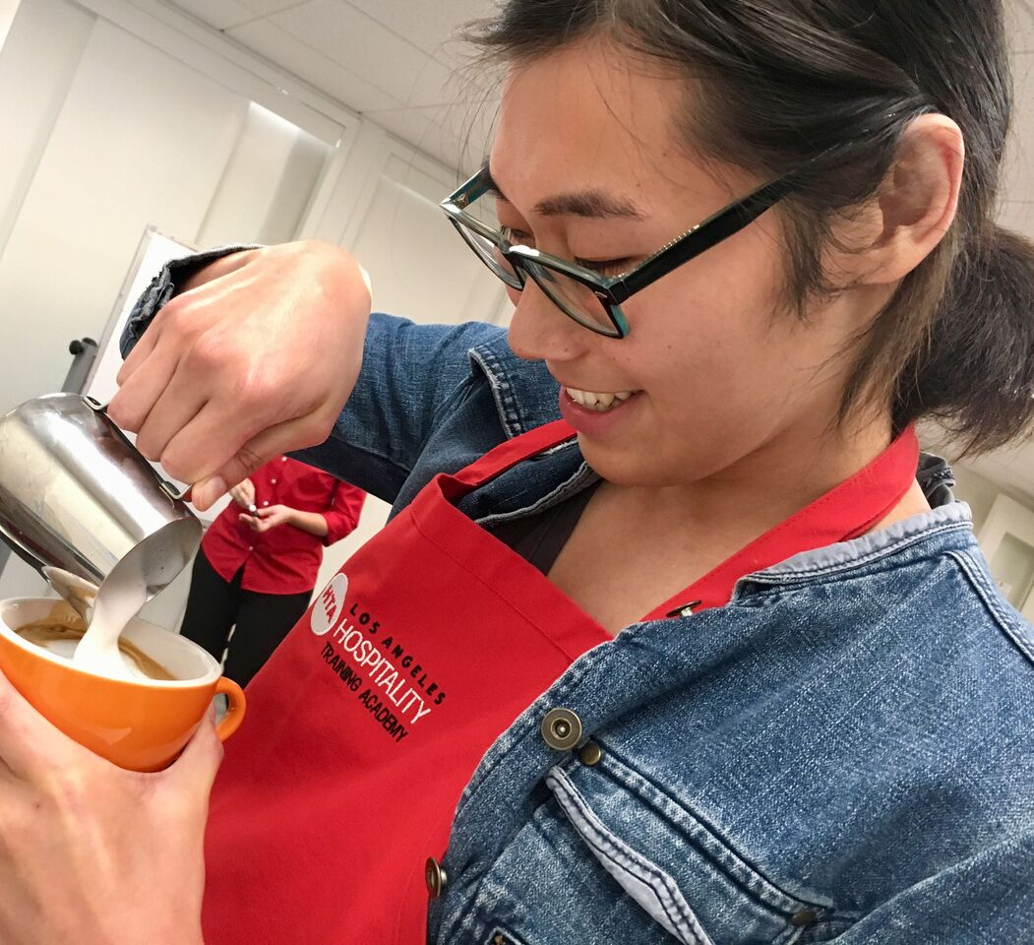

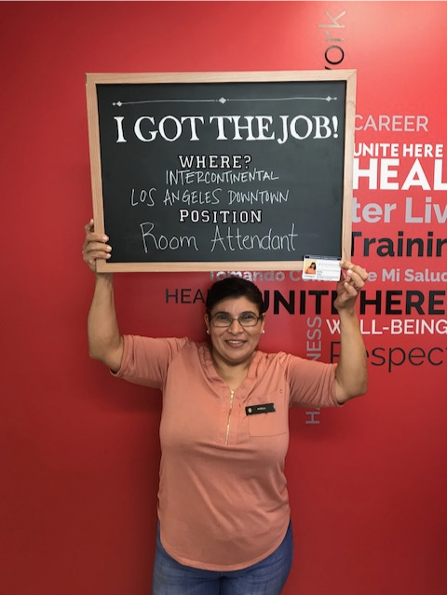
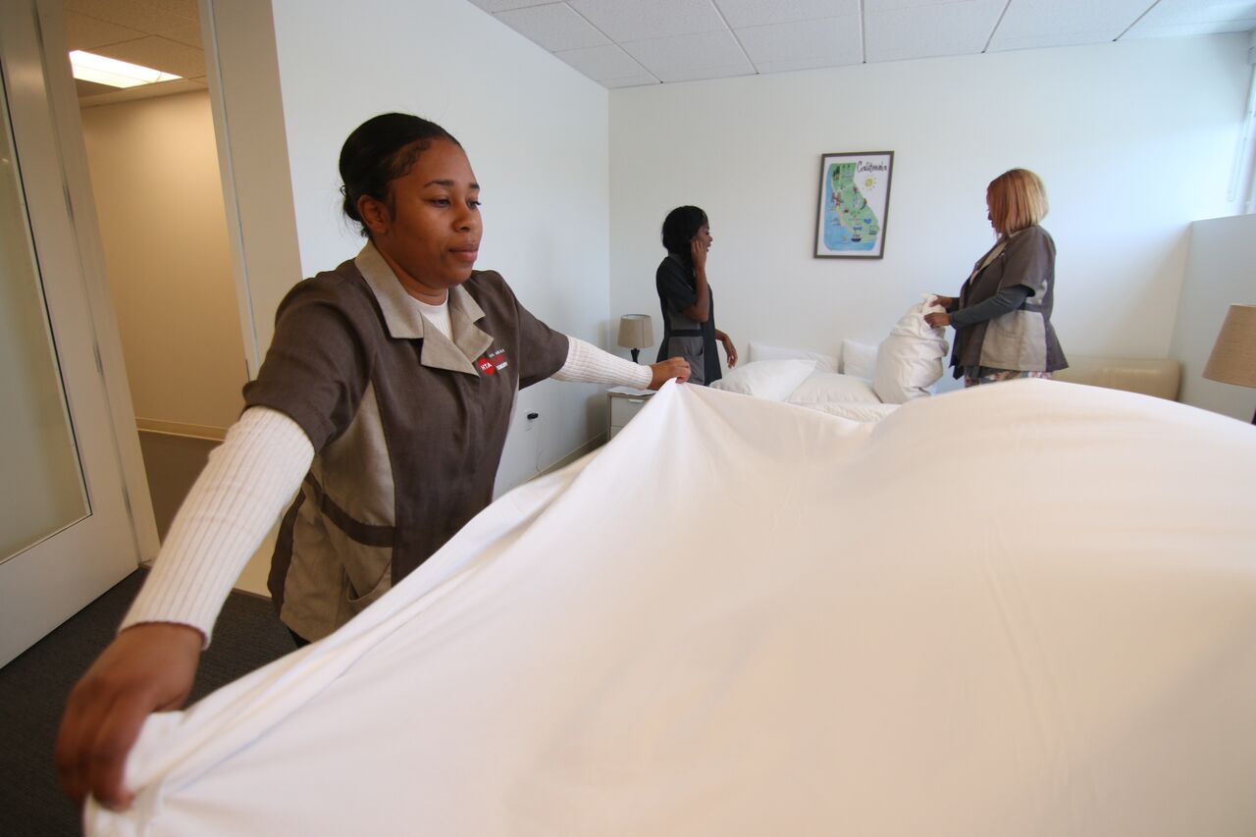
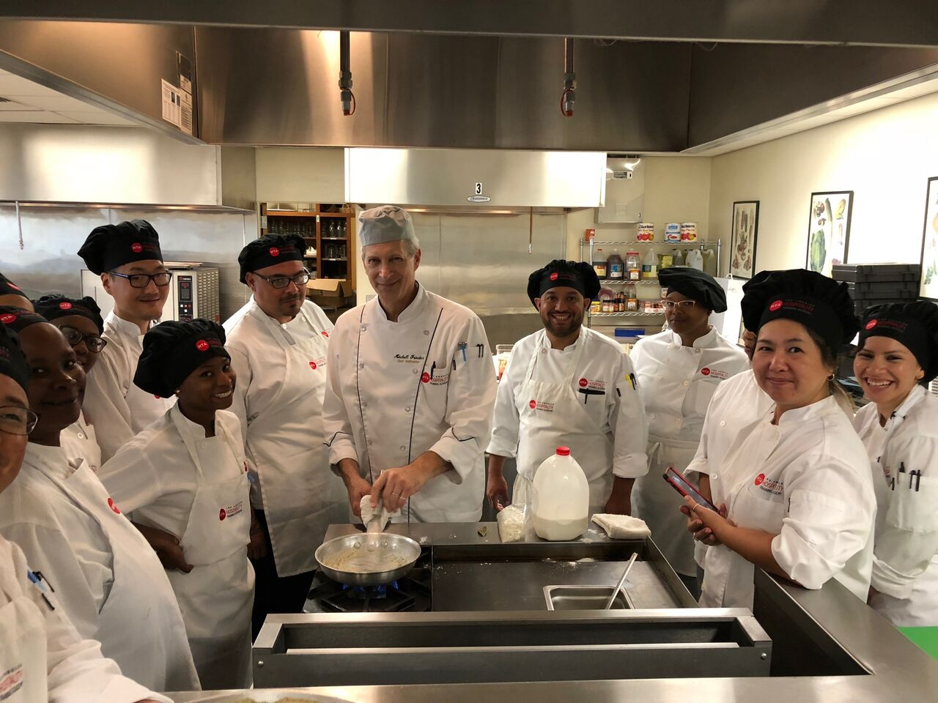
Our Training Programs
LAX/Hospitality Worker
Barista
U.S. DOL and CA DAS registered Culinary Apprenticeship
U.S. DOL and CA DAS registered Room Attendant Apprenticeship
Vocational ESL in partnership with LAUSD Division of Adult and Career Education (DACE)

Slide 8
Our Goals
Train individuals for in-demand jobs in the hospitality industry
Put qualified candidates in front of HR Directors, Hiring Managers, Supervisors and Executive Chefs from our 160 employer partners at the end of training
  Provide mock interviewing, resume writing and job skills in preparation for interviews
Create a career pathway with union jobs, good wages, health and pension benefits, and legal fund access
Continue to case manage participants after they receive an offer of employment and begin their job to track retention

Slide 9
The Recipe for Success: Creating Connections Between Survivors of DV/HT and Workforce Development
Applied for the Accelerator 7.0 Grant via the California Workforce Development Board
  Our big idea is to bridge the LA County and City DV/HT providers with workforce development to improve services for 30 survivors over 18 months
  This will include survivors who are immigrants, ex-offenders, CalWORKs participants, long-term unemployed and low-income individuals
  HTA has procured Peace Over Violence to act as a liaison with partners to facilitate referrals and communication to ensure regulatory compliance and confidentiality, and draft policies and procedures on client confidentiality, referrals, case conferencing and long-term data protection
  HTA has procured House of Overcome, NFP, headed by social worker Vericia R. Miller, as an SME to provide 10-hours of training for HTA staff on DV and HT subject matter

